Slide 1
CONSERVATION BIOLOGY
UNIT 7. ASSESSMENT CRITERIA FOR SPECIES AND AREAS
7.1. General assessment criteria.
7.2. Criteria for the assessment of species. The IUCN.
7.3. Criteria for the assessment of areas.

Slide 2
UNIT 7. ASSESSMENT CRITERIA FOR SPECIES AND AREAS
7.1. General assessment criteria :
Conservationists believe that every species has intrinsic value. Its value is independent of its usefulness to other species (including people). If we accept this idea it is relatively difficult to decide which species merit more attention from conservation biologists.
Level of priority: Biosphere, Biomes, Ecosystems, Species, Genes?
Unfortunately the economic resources devoted to conservation are limited.
There are red lists or red books and official lists of species/habitats that could help in the decision.

Slide 3
UNIT 7. ASSESSMENT CRITERIA FOR SPECIES AND AREAS
7.1. General assessment criteria :
Valuation of Nature in Conservation and Restoration:
http://www.webpages.uidaho.edu/css385/Readings/SWART%20nature%20valuation.pdf
What is true, what is right and what is beautiful? Philosophy, ethic and aesthetic.
Ecological Perspective, Ethical Perspective, Aesthetic Perspective.
Valuation Approaches: Wilderness (typical in Ecological perspective), Arcadian (dehesas), Functional (traditional crops, livestock races, etc. Anthropocentric!)

Slide 4
UNIT 7. ASSESSMENT CRITERIA FOR SPECIES AND AREAS
7.1. General assessment criteria :
Stephen Keller, 1986:
Naturalistic and outdoor recreation values that relate to enjoyment from direct contact with wildlife.
Ecological values associated with the importance of a species to other flora and fauna and to the maintenance of ecosystem processes.
Moral or existential values associated with inherent rights or spiritual importance of species.
Scientific values: actual o potential values associated with a species’ contribution to enhancing human knowledge and understanding of the natural world.
Aesthetic values associated with a species’ possession of beauty or other qualities admired by humans.
Utilitarian values associated with species as sources of material benefit or use.
Cultural, symbolic, or historical values associated with strong personal or cultural attachments of human cultural groups to a species, especially associated with symbolic meanings and identification between the species and humans.

Slide 5
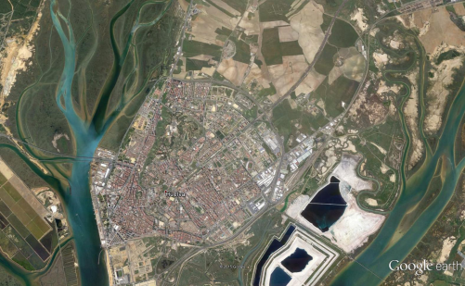
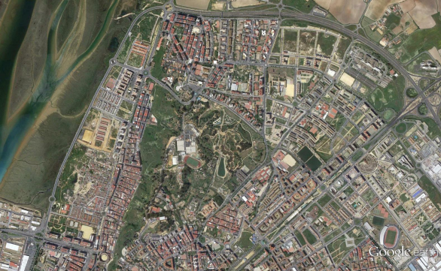
UNIT 7. ASSESSMENT CRITERIA FOR SPECIES AND AREAS
7.1. General assessment criteria :
Stephen Keller, 1986:
Naturalistic and outdoor recreation values that relate to enjoyment from direct contact with wildlife.
Parque Moret

Slide 6
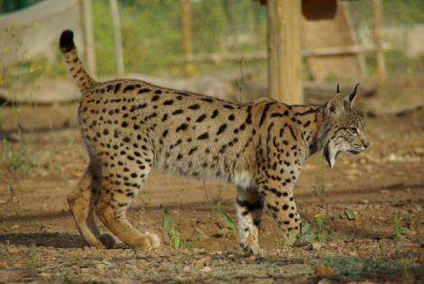
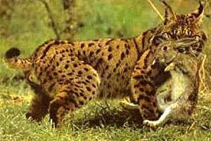
UNIT 7. ASSESSMENT CRITERIA FOR SPECIES AND AREAS
7.1. General assessment criteria :
Stephen Keller, 1986:
Ecological values associated with the importance of a species to other flora and fauna and to the maintenance of ecosystem processes.
Iberian lynx (Lynx pardinus)

Slide 7
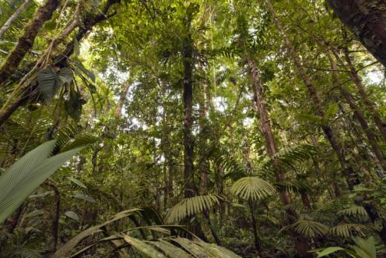
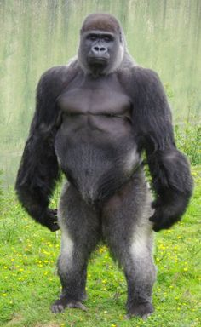
UNIT 7. ASSESSMENT CRITERIA FOR SPECIES AND AREAS
7.1. General assessment criteria :
Stephen Keller, 1986:
Moral or existential values associated with inherent rights or spiritual importance of species.
Gorillas
Amazonian forests

Slide 8
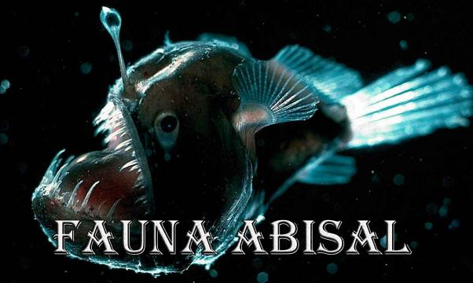
UNIT 7. ASSESSMENT CRITERIA FOR SPECIES AND AREAS
7.1. General assessment criteria :
Stephen Keller, 1986:
Scientific values: actual o potential values associated with a species’ contribution to enhancing human knowledge and understanding of the natural world.
Abyssal fauna

Slide 9
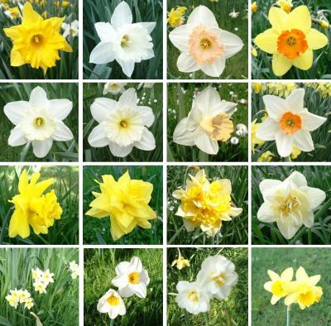
UNIT 7. ASSESSMENT CRITERIA FOR SPECIES AND AREAS
7.1. General assessment criteria :
Stephen Keller, 1986:
Aesthetic values associated with a species’ possession of beauty or other qualities admired by humans.
Narcissus (daffodil)

Slide 10
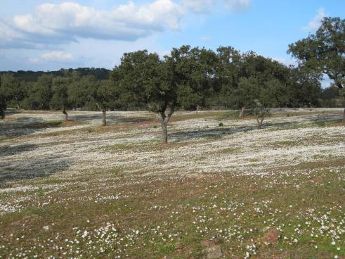
UNIT 7. ASSESSMENT CRITERIA FOR SPECIES AND AREAS
7.1. General assessment criteria :
Stephen Keller, 1986:
Utilitarian values associated with species as sources of material benefit or use.
Dehesa. Agroforestry system.
Holm-oak.

Slide 11
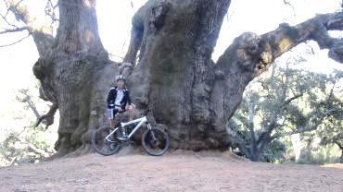
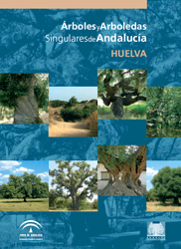
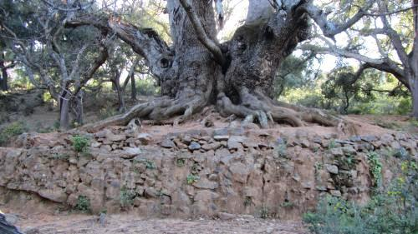
UNIT 7. ASSESSMENT CRITERIA FOR SPECIES AND AREAS
7.1. General assessment criteria :
Stephen Keller, 1986:
Cultural, symbolic, or historical values associated with strong personal or cultural attachments of human cultural groups to a species, especially associated with symbolic meanings and identification between the species and humans.
Castaño Santo (Málaga)

Slide 12
UNIT 7. ASSESSMENT CRITERIA FOR SPECIES AND AREAS
7.1. General assessment criteria :
Economically
Acceptable
Options
Rational
Environmental
Policy
Ecologically
Acceptable
Options
Norton, 1991

Slide 13
UNIT 7. ASSESSMENT CRITERIA FOR SPECIES AND AREAS
7.2. Species assessment:
Economic value.
Ecological value (keystone species).
Charismatic value: environmental education! Iberian lynx.
Weirdness or rarity. Biogeographical interest.
Endangered. Red list (IUNC, National, Andalusia). Habitat Directive (annex II)

Slide 14
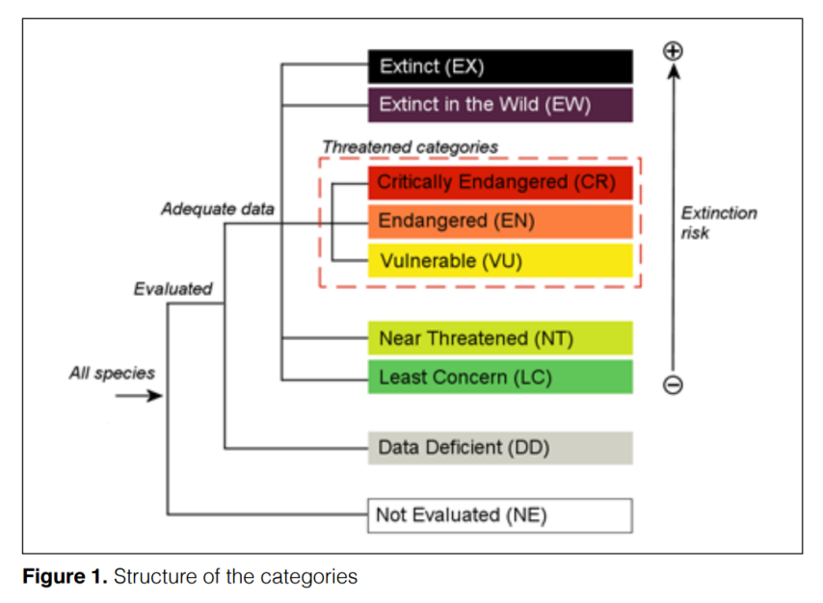
http://jr.iucnredlist.org/documents/redlist_cats_crit_en.pdf

Slide 15
EXTINCT (EX)
A taxon is Extinct when there is no reasonable doubt that the last individual has died. A
taxon is presumed Extinct when exhaustive surveys in known and/or expected habitat,
at appropriate times (diurnal, seasonal, annual), throughout its historic range have failed
to record an individual. Surveys should be over a time frame appropriate to the taxon’s
life cycle and life form.
EXTINCT IN THE WILD (EW)
A taxon is Extinct in the Wild when it is known only to survive in cultivation, in captivity
or as a naturalized population (or populations) well outside the past range. A taxon is
presumed Extinct in the Wild when exhaustive surveys in known and/or expected habitat,
at appropriate times (diurnal, seasonal, annual), throughout its historic range have failed
to record an individual. Surveys should be over a time frame appropriate to the taxon’s
life cycle and life form.
CRITICALLY ENDANGERED (CR)
A taxon is Critically Endangered when the best available evidence indicates that it meets
any of the criteria A to E for Critically Endangered (see Section V), and it is therefore
considered to be facing an extremely high risk of extinction in the wild.
ENDANGERED (EN)
A taxon is Endangered when the best available evidence indicates that it meets any of the
criteria A to E for Endangered (see Section V), and it is therefore considered to be facing
a very high risk of extinction in the wild.
VULNERABLE (VU)
A taxon is Vulnerable when the best available evidence indicates that it meets any of the
criteria A to E for Vulnerable (see Section V), and it is therefore considered to be facing a
high risk of extinction in the wild.
NEAR THREATENED (NT)
A taxon is Near Threatened when it has been evaluated against the criteria but does not
qualify for Critically Endangered, Endangered or Vulnerable now, but is close to qualifying
for or is likely to qualify for a threatened category in the near future.
LEAST CONCERN (LC)
A taxon is Least Concern when it has been evaluated against the criteria and does not
qualify for Critically Endangered, Endangered, Vulnerable or Near Threatened. Widespread
and abundant taxa are included in this category.
DATA DEFICIENT (DD)
A taxon is Data Deficient when there is inadequate information to make a direct, or
indirect, assessment of its risk of extinction based on its distribution and/or population
status. A taxon in this category may be well studied, and its biology well known, but
appropriate data on abundance and/or distribution are lacking. Data Deficient is therefore
not a category of threat. Listing of taxa in this category indicates that more information is
required and acknowledges the possibility that future research will show that threatened
classification is appropriate. It is important to make positive use of whatever data are
available. In many cases great care should be exercised in choosing between DD and a
threatened status. If the range of a taxon is suspected to be relatively circumscribed, and
a considerable period of time has elapsed since the last record of the taxon, threatened
status may well be justified.
NOT EVALUATED (NE)
A taxon is Not Evaluated when it has not yet been evaluated against the criteria.

Slide 16
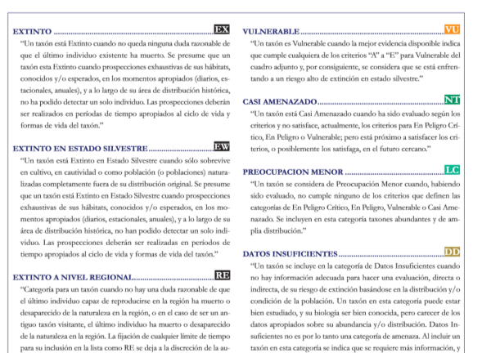
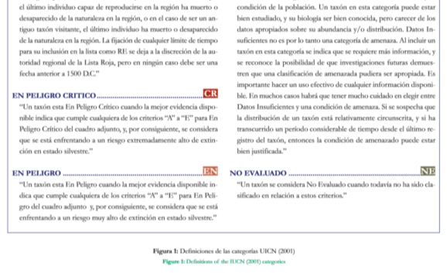

Slide 17
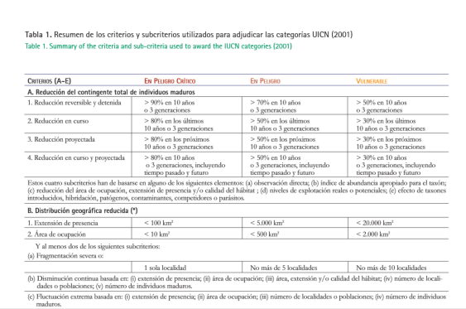
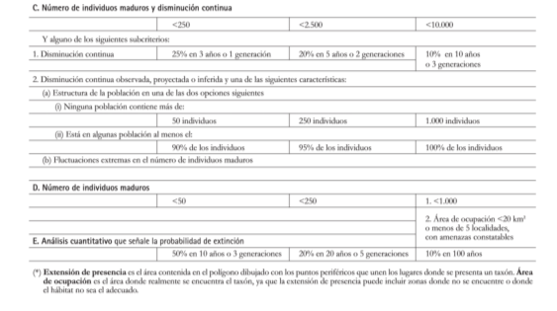

Slide 18
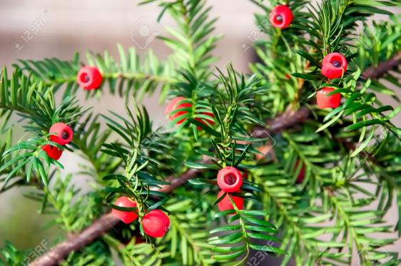
UNIT 7. ASSESSMENT CRITERIA FOR SPECIES AND AREAS
HABITAT DIRECTIVE:
COUNCIL DIRECTIVE 92/43/EEC of 21 May 1992 on the conservation of natural habitats and of wild fauna and flora. Annex II.
http://eur-lex.europa.eu/legal-content/EN/TXT/?uri=CELEX:01992L0043-20070101
Example: Taxus baccata:
IUCN: Lc.
España: not considered.
Junta de Andalucía: Vu.

Slide 19
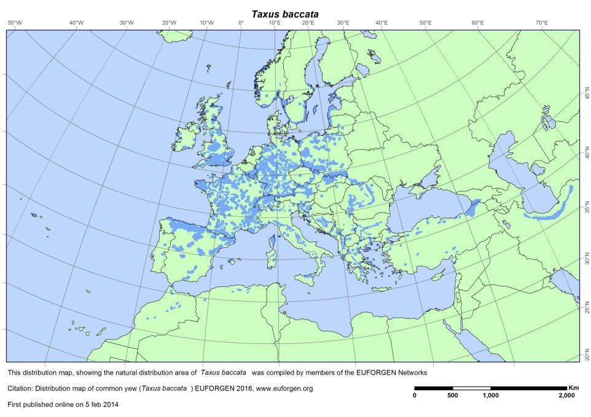

Slide 20
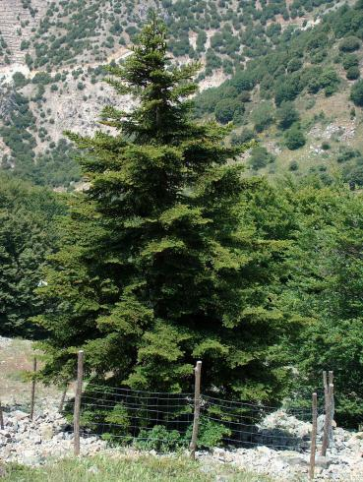
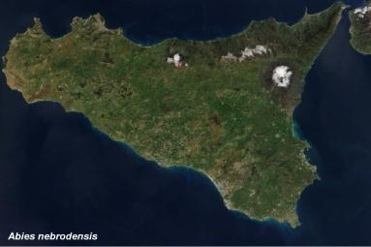
UNIT 7. ASSESSMENT CRITERIA FOR SPECIES AND AREAS
HABITAT DIRECTIVE:
COUNCIL DIRECTIVE 92/43/EEC of 21 May 1992 on the conservation of natural habitats and of wild fauna and flora. Annex II.
http://eur-lex.europa.eu/legal-content/EN/TXT/?uri=CELEX:01992L0043-20070101
Example: Abies nebrodensis:
IUCN: Cr.
Annex II, Habitat Directive.
30 individuals!!!

Slide 21
UNIT 7. ASSESSMENT CRITERIA FOR SPECIES AND AREAS
7.3. Areas assessment:
TEXT: http://eur-lex.europa.eu/legal-content/EN/TXT/?uri=CELEX:01992L0043-20070101
CARDS: http://www.magrama.gob.es/es/biodiversidad/temas/espacios-protegidos/red-natura-2000/rn_tip_hab_esp_espana_acceso_fichas.aspx
RED NATURA 2000: SAC (Annex I, Habitat Directive, Special Areas of Conservation) + SPA (Special Protection Areas, Birds Directive)
Example:
Natural protected sites. Habitat Directive (Annex I): NATURAL HABITAT TYPES OF COMMUNITY INTEREST WHOSE CONSERVATION REQUIRES THE DESIGNATION OF SPECIAL AREAS OF CONSERVATION.

Slide 22
UNIT 7. ASSESSMENT CRITERIA FOR SPECIES AND AREAS
7.3. Areas assessment:
Example:
Ramsar Convention
The Convention on Wetlands of International Importance, called the Ramsar Convention, is the intergovernmental treaty that provides the framework for the conservation and wise use of wetlands and their resources.
The Convention was adopted in the Iranian city of Ramsar in 1971 and came into force in 1975. Since then, almost 90% of UN member states, from all the world’s geographic regions, have acceded to become “Contracting Parties”.
http://www.ramsar.org/

Slide 23
UNIT 7. ASSESSMENT CRITERIA FOR SPECIES AND AREAS
7.3. Areas assessment:
Example:
Man and the Biosphere Programme
Launched in 1971, UNESCO’s Man and the Biosphere Programme (MAB) is an Intergovernmental Scientific Programme that aims to establish a scientific basis for the improvement of relationships between people and their environments.
MAB combines the natural and social sciences, economics and education to improve human livelihoods and the equitable sharing of benefits, and to safeguard natural and managed ecosystems, thus promoting innovative approaches to economic development that are socially and culturally appropriate, and environmentally sustainable.
Its World Network of Biosphere Reserves currently counts 651 biosphere reserves in 120 countries all over the world.
http://www.unesco.org/new/en/natural-sciences/environment/ecological-sciences/man-and-biosphere-programme/

Slide 24
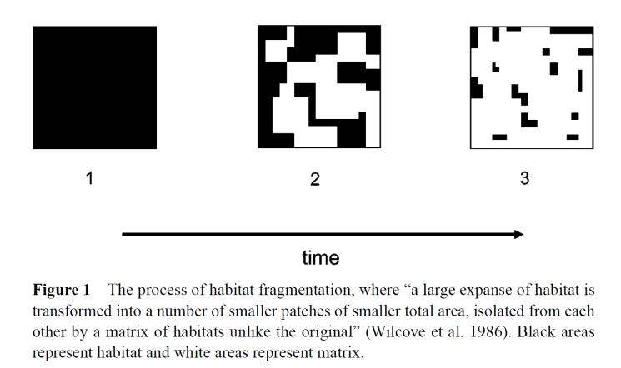
UNIT 7. ASSESSMENT CRITERIA FOR SPECIES AND AREAS
7.3. Areas assessment:
Example: Landscape fragmentation, priorities.
Fahrig L. Annu. Rev. Ecol. Evol. Syst. 2003. 34:487–515

Slide 25
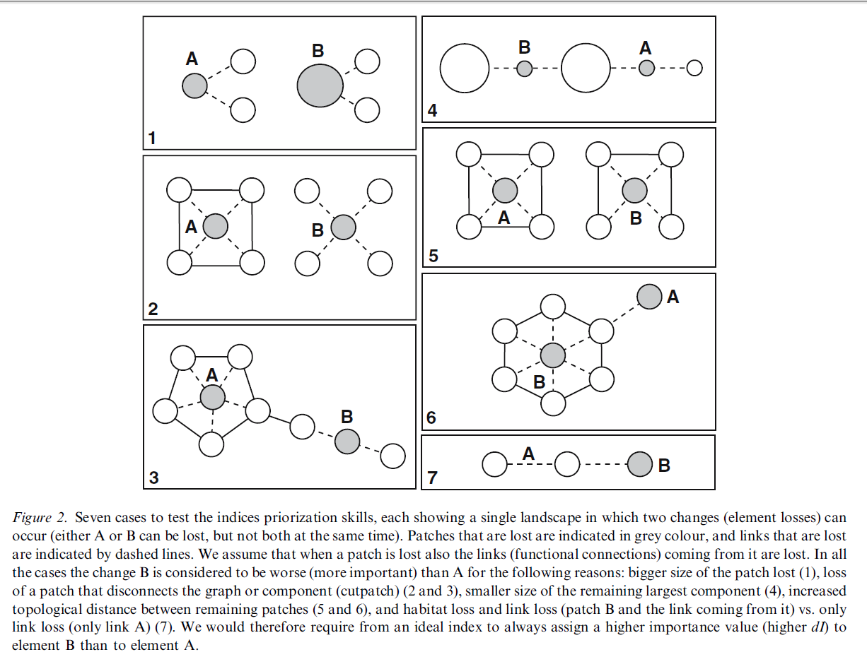
Fahrig L. Annu. Rev. Ecol. Evol. Syst. 2003. 34:487–515

Slide 26
A
B
A
B
C
A
B
1
2
3
B
A
B
C
A
A
B
4
5
6

